Slide 1
Study Design
Measuring risks and benefits
of soft robots
Philosophy
Psychology
Robotics
Background Information
Literature review on ethics and soft robots
Our focus RQ 2
RQ 2: qualitatively survey layperson perception on soft robots
RQ 1, 2, 3: quantitatively survey layperson perception on soft robots
search and rescue missions
Welcome and consent
Random assignment
Draw CAM
Adjust drawn CAM
Add information on soft robots
socially assistive
RQ additional?: qualitatively survey expert evaluation on risks and benefits
Expert evaluation on risks and benefits of soft robots within livMatS
Open question on risks and benefits of SR

Slide 2
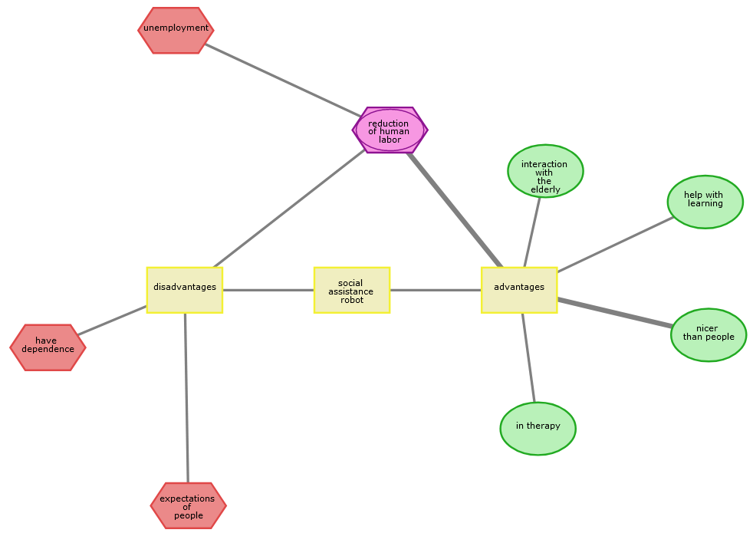
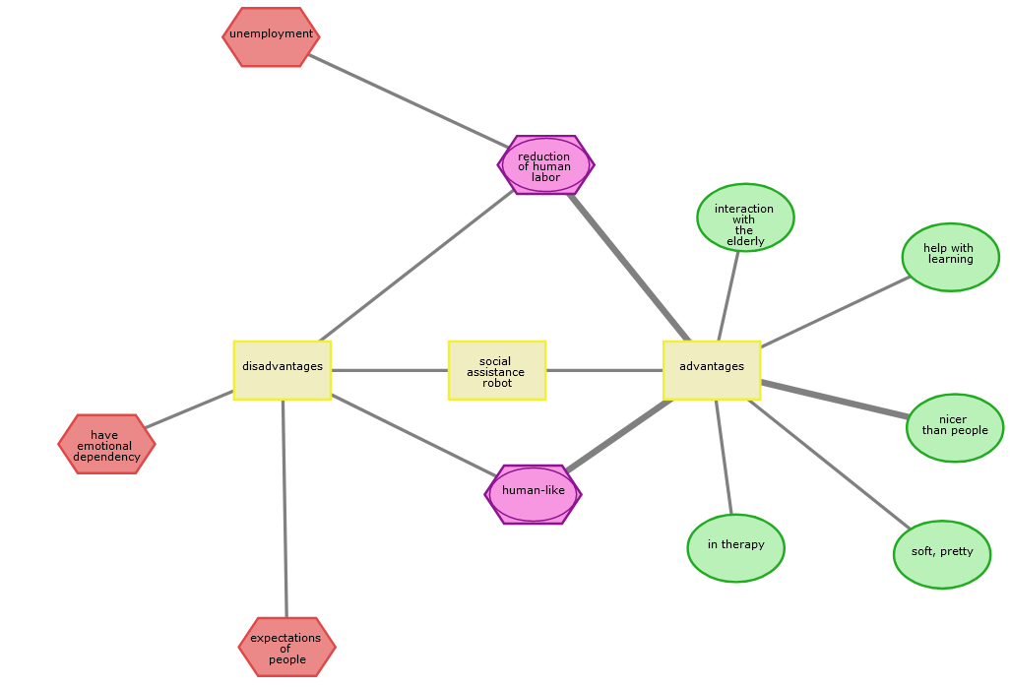
Intervention Design: Outcome
Draw CAM
Add information on soft robots
Adjust drawn CAM
Participant with ID: 6517299ba3d7cde45394692a

Slide 3
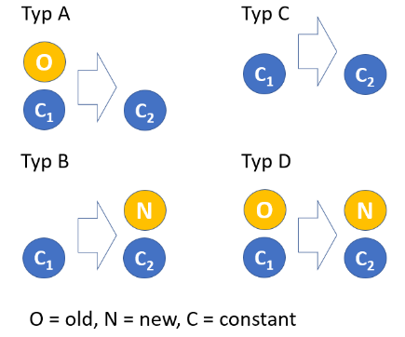
R2: Perceived risks and benefits qualitative: CAM semantic content
Draw CAM
Add information on soft robots
Adjust drawn CAM
Resulting types
A B C D
1 145 39 39
Only B, D added new concepts
Participant with ID: 6517299ba3d7cde45394692a

